Slide 1

StapleIT! Database
Ethan Decker

Slide 2
Intro
- This project was to emulate the inventory system as much as possible from Staples where I currently work
- The idea is that this is just a local office supply store that has become too big to just use spreadsheets. It was time for a database.
- This is the beginning of the inventory system to keep track of inventory and shipments

Slide 3

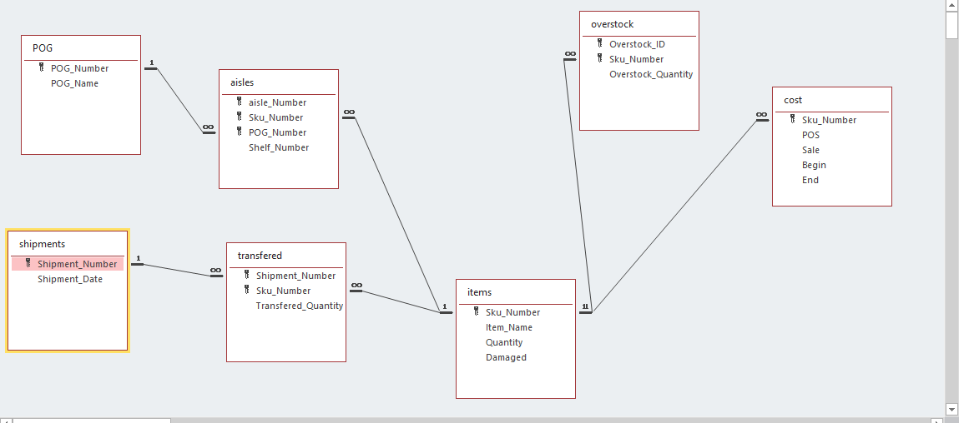
Relationships

Slide 4
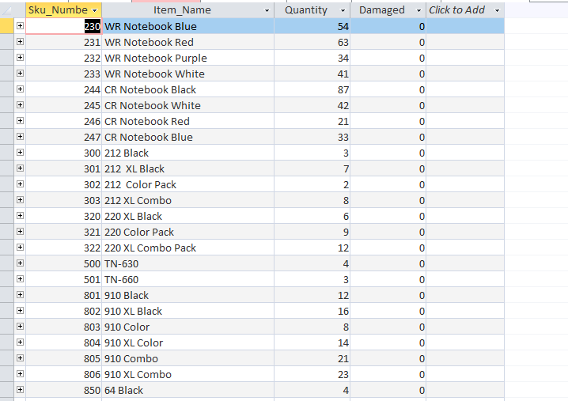
Items Table
-This is the most important table that holds the basic information on ever item.

Slide 5
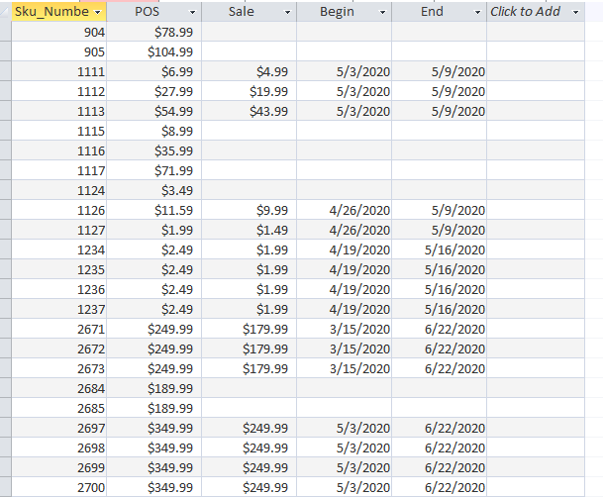
Cost Table
- This table displays the cost and the sale (if there is one) of each item

Slide 6
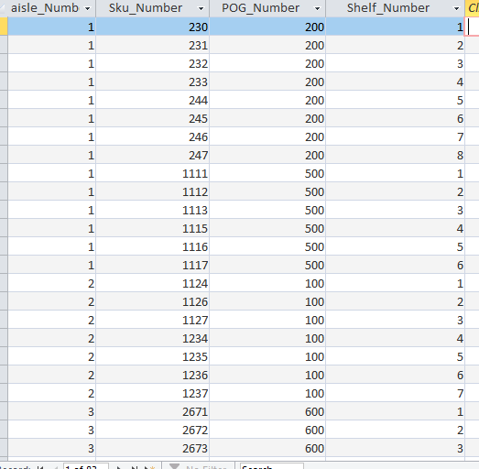
Aisle Table
This table is an intersection table between items and POG. It has the aisle number and the shelf location.

Slide 7
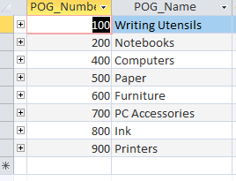
POG Table
Each POG is a section of the store that has one category of products

Slide 8
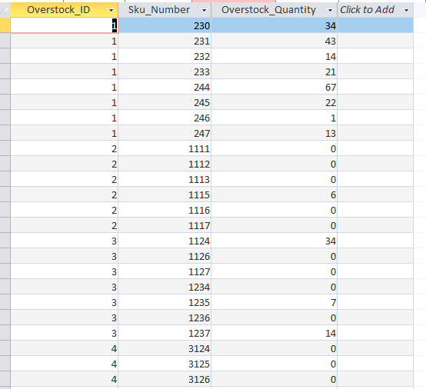
Overstock Table
- This is an idea I had for the inventory system that would keep track of what items are in overstock (if they can be put in overstock) so that it can be kept track of where things are and how many items are on the floor at once.

Slide 9
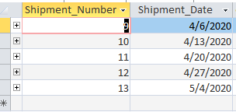
Shipment Table
The shipment table simply has all the shipments as well as the date they occurred

Slide 10
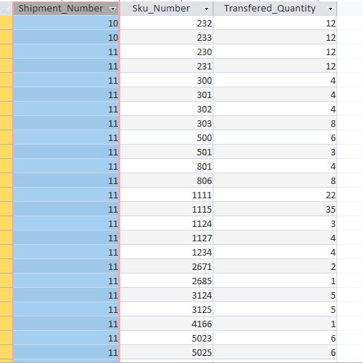
Transferred Table
Transferred Table is the intersection data table between shipments and items. It has all the items that were shipped in as well as how many and when.

Slide 11
Inventory report

Slide 12
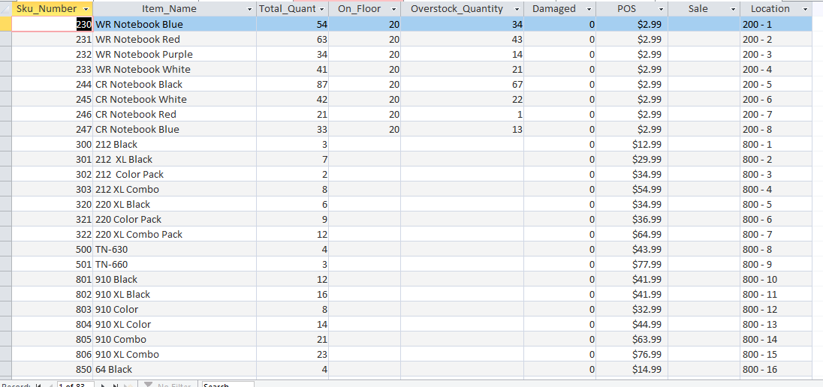
Inventory Report
This report shows everything you would want to know about all the items in the inventory. How many there are, how many are on the floor/overstock if they have an overstock location, the sale, and the location on the floor.

Slide 13
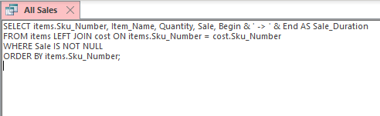
All sales report

Slide 14
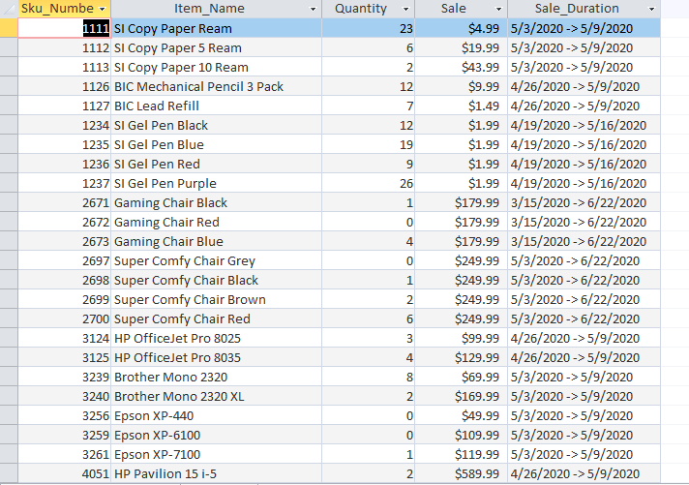
All Sales Report
This report shows all the sales that are currently going on. It shows the item, how many there are, the sale price, and the duration of the sale.

Slide 15
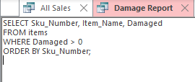
Damage report

Slide 16
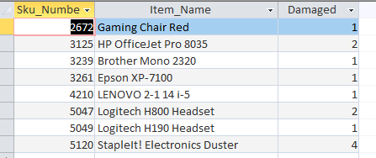
Damage Report
This report shows every single item that has been damaged out and is ready to be processed to the next step (destroyed or sent back to the manufacturer)

Slide 17

Holes report

Slide 18
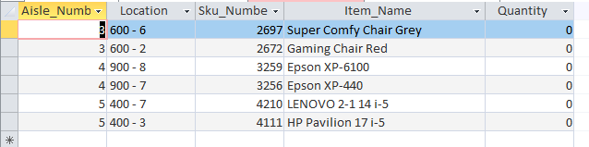
Holes Report
- The Holes Report is similar to the Zeroes Report, but instead shows all of the ‘holes’ in the locations. This shows where items could be flexed so that the POG does not look empty.

Slide 19
Notebook shipment report

Slide 20
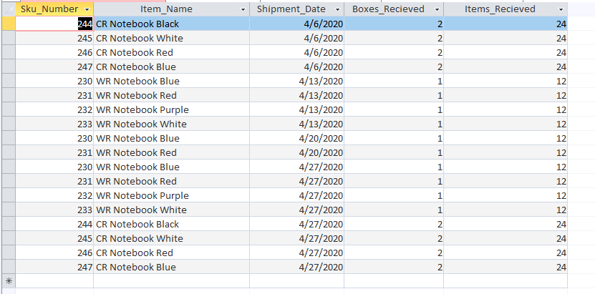
Notebook Shipment Report
This is an example of a report to showcase a category of items and to see when they have been shipped recently. This is important for times like Back To School when it’s important to see if we have been getting the shipments of notebooks for everyone coming in.

Slide 21
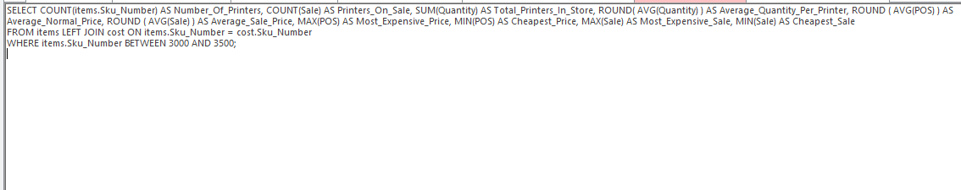
Printer report

Slide 22
Printers Report
- This form shows a lot of important things like how many of the item there are, what is the cheapest price, etc. to gain information on one area of the store.

Slide 23
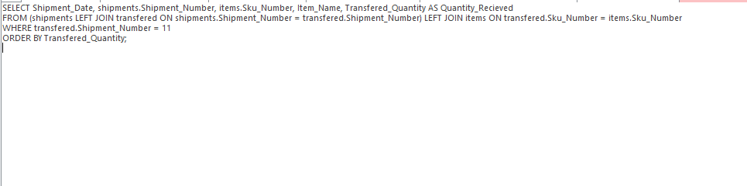
Shipment #11 report

Slide 24
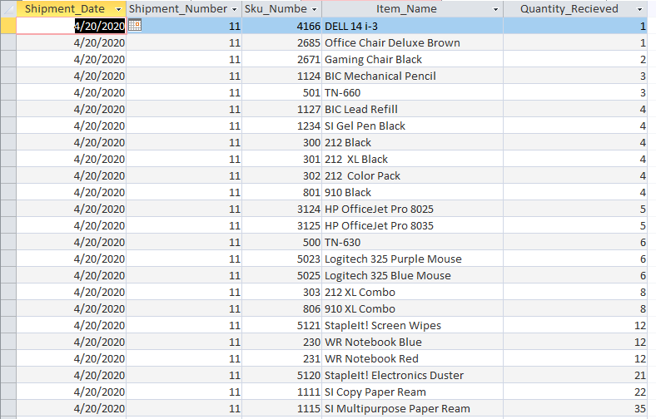
Shipment #11 Report
- This is an example of a report after going through a Monday truck shipment. It displays everything that was received from the shipment.

Slide 25
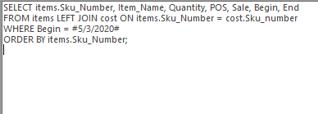
What sales start this week report

Slide 26
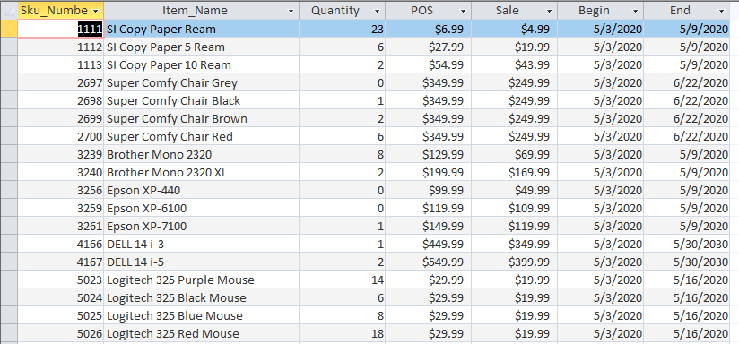
What Sales Start Report
-This report is important because it shows what sales are starting this week. It is useful to see on Friday nights or Saturday nights before changing the signs so that one can properly prepare for what sales are starting. This also helps prepare the associates to know what items to push.

Slide 27
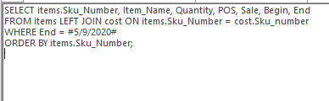
WHAT SALES END THIS Week report

Slide 28
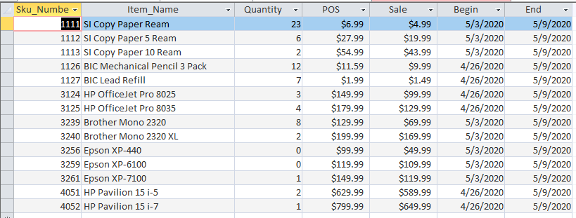
What Sales End Report
-The importance of this is the same as the last report. It’ll help the associate know what signs they are going to have to take down.

Slide 29
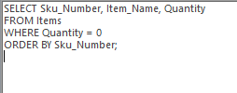
Zeroes report

Slide 30
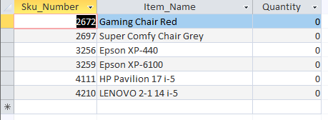
Zeroes Report
This report gives the managers a heads up which items are out of stock and need to be ordered as well as alerting them to tell customers to check online for these items.

